Slide 1
MALIGNANT COMMENTS CLASSIFICATION
By TWINKLE PATEL

Slide 2
USE CASE:
The proliferation of social media enables people to express their opinions widely online. However, at the same time, this has resulted in the emergence of conflict and hate, making online environments uninviting for users. Although researchers have found that hate is a problem across multiple platforms, there is a lack of models for online hate detection.
Online hate, described as abusive language, aggression, cyberbullying, hatefulness and many others has been identified as a major threat on online social media platforms. Social media platforms are the most prominent grounds for such toxic behaviour.
Our goal is to build a prototype of online hate and abuse comment classifier which can used to classify hate and offensive comments so that it can be controlled and restricted from spreading hatred and cyberbullying.

Slide 3
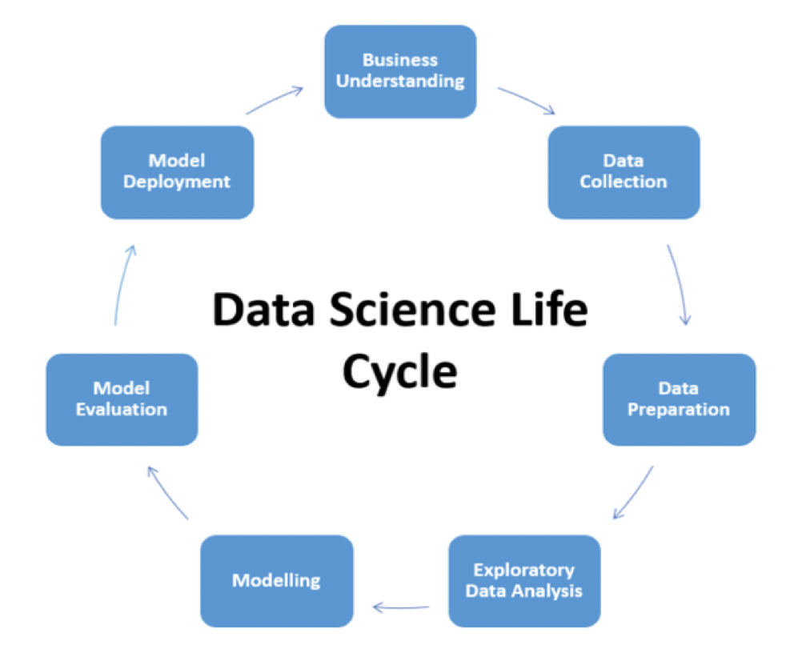
APPROACH AND LIFE CYCLE :

Slide 4
DATA DESCRIPTION :
Project contain train and test dataset.
In train data set there are 159,571 rows and 8 columns.
In test data set it is like 153,164 rows and 2 columns.
There are no null values in the dataset
Most of the data are numeric in nature which are binary.
Comments is object in nature and consist of text.
Overall memory usage for train and test is around 15MB.

Slide 5
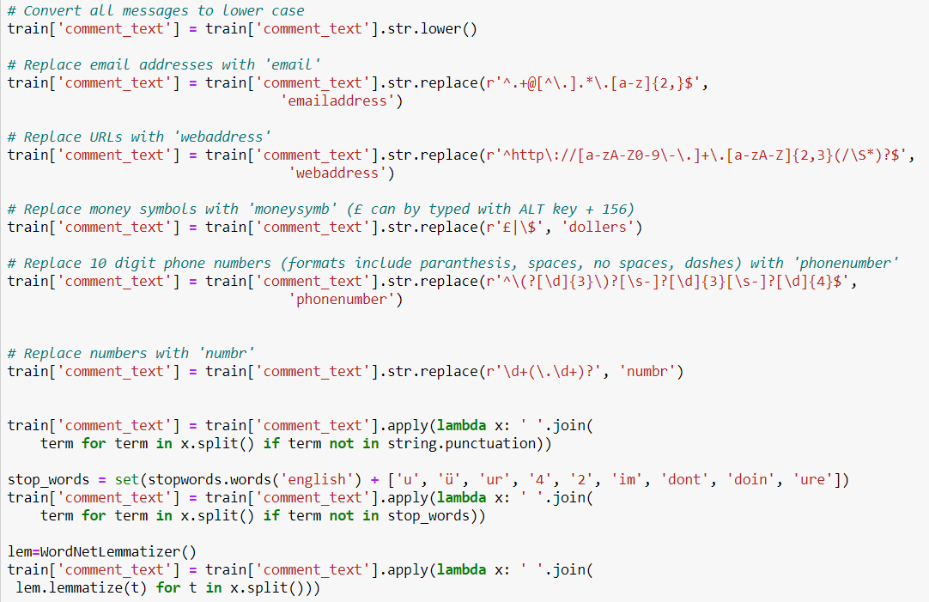
DATA PRE-PROCESSING :
# AS THERE ARE NO NULL VALUES IN THE DATASET, BUT AS THE COMMENT COLUMN IN TEXT FORMAT SO THERE REQUIRE LOT OF TEXT PRE-PROCESSING.

Slide 6
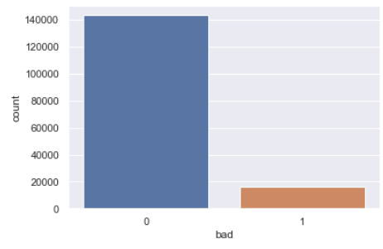
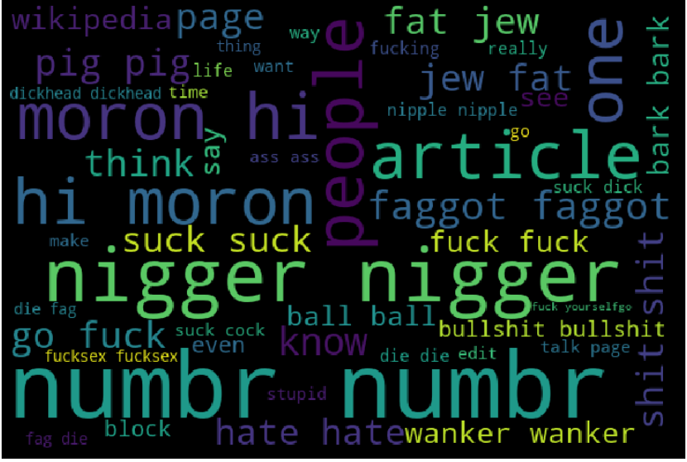
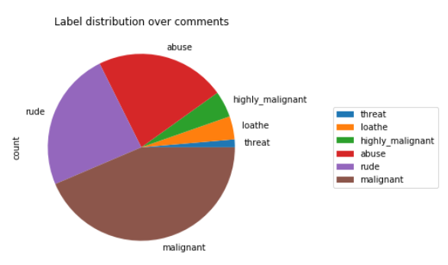
EDA :

Slide 7
MODEL BUILDING :
The model building process involves setting up ways of collecting data, understanding and paying attention to what is important in the data to answer the questions you are asking, finding a statistical, mathematical or a simulation model to gain understanding and make predictions.
Evaluation Matrices:
Accuracy - it determines how often a model predicts default and non default correctly.
Precision-it calculates whenever our models predicts it is default how often it is correct.
Recall- Recall regulate the actual default that the model is actually predict.
Precision Recall Curve - PRC will display the tradeoff between Precision and Recall threshold.
F1 score - the F1-score, is a measure of a model's accuracy on a dataset. It is used to evaluate binary classification systems, which classify examples into 'positive' or 'negative'.
Cross Validations:
K Fold cross validations , K = 10

Slide 8
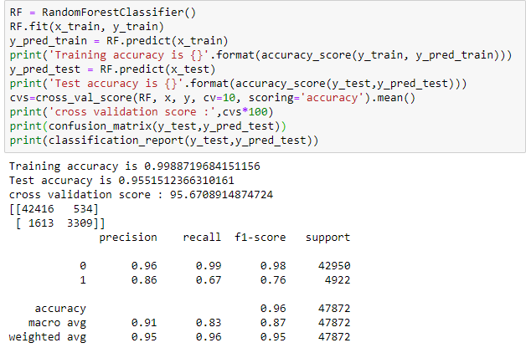
# RANDOM FOREST CLASSIFIER GIVING BEST RESULTS AMONGST ALL ALGORITHMS :
Random forest, like its name implies, consists of a large number of individual decision trees that operate as an ensemble. Each individual tree in the random forest spits out a class prediction and the class with the most votes becomes our model’s prediction
Random forests or random decision forests are an ensemble learning method for classification, regression and other tasks that operate by constructing a multitude of decision trees at training time and outputting the class that is the mode of the classes (classification) or mean/average prediction (regression) of the

Slide 9
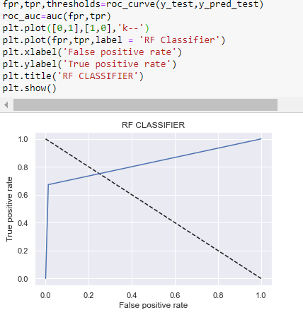
ROC-CURVE :
An ROC curve (receiver operating characteristic curve) is a graph showing the performance of a classification model at all classification thresholds. This curve plots two parameters: True Positive Rate. False Positive Rate
Most of area is lying under the curve and providing the high true positive rate approx. 85% which is good sign of better prediction

Slide 10
CONCLUSIONS :
In this project there are some variables like malignant and rude which are highly correlated it is possible because one comment text may have combination of multiple features.
There were no null values in the data set only the pre processing is required.
Removing the column id does not impact the model training.
Using decision tree, model can reduce the false negative values
It has future scope in various use cases likewise in election, social media etc, where every day there are multi offensive comments spread.
Random forest is well suitable for this project as it used tree internally and it used multiple weak learner and generate the strong model and generate low bias and low variance model.

